Slide 1
MILESTONE 4
ADVANCED SECURITY & PREDICTIVE ANALYTICS
Extended Dashboard
Development and Advanced
Hospital Security Intelligence
TEAM 2
Kunal • Dinesh • Sarumathi
Power BI • Data Analytics
Extending the previous Dashboard Development Phase with advanced security risk assessment,
vulnerability analysis, smart alerts, performance optimisation, scenario analysis, and
predictive threat analytics.
Dataset: Healthcare, Hospitality and Security Trends Dataset
Team 2 • Healthcare, Hospitality & Security Trends
1

Slide 2
MILESTONE 4 • OVERVIEW
Project Overview
Milestone 4 is the continuation and extension of the previous Dashboard Development Phase. The project now advances into an advanced hospital security analytics and decision-support system.
Previous Phase
Milestone 4 Extension
✓ Data preprocessing and preparation
→ Security Risk Assessment
✓ Dashboard development
→ Security Vulnerability Analysis
→ Resource Exposure Analysis
✓ KPI creation
►
→ Smart Alert and Early Warning
✓ Interactive Power BI visualisation
→ Performance Optimisation
✓ Analysis of hospital performance and trends
→ Scenario Analysis
→ Predictive Hospital Threat Analytics
Team 2 • Healthcare, Hospitality & Security Trends
2

Slide 3
MILESTONE 4 • OBJECTIVES & METHODOLOGY
Milestone 4 Objectives & Workflow
OBJECTIVES
WORKFLOW
1
Identify hospitals with high and critical security risks.
Dataset
2
Analyse vulnerabilities and security resource exposure.
▼
Security Metrics
3
Monitor and prioritise active alerts.
▼
Risk & Vulnerability Analysis
4
Identify hospitals requiring immediate attention.
▼
Alert Prioritisation
5
Compare current and simulated risk scenarios.
▼
6
Analyse relationships between security resources and operational demand.
Scenario Optimisation
▼
7
Generate predictive insights related to hospital threat levels.
Predictive Threat Analysis
Team 2 • Healthcare, Hospitality & Security Trends
3

Slide 4
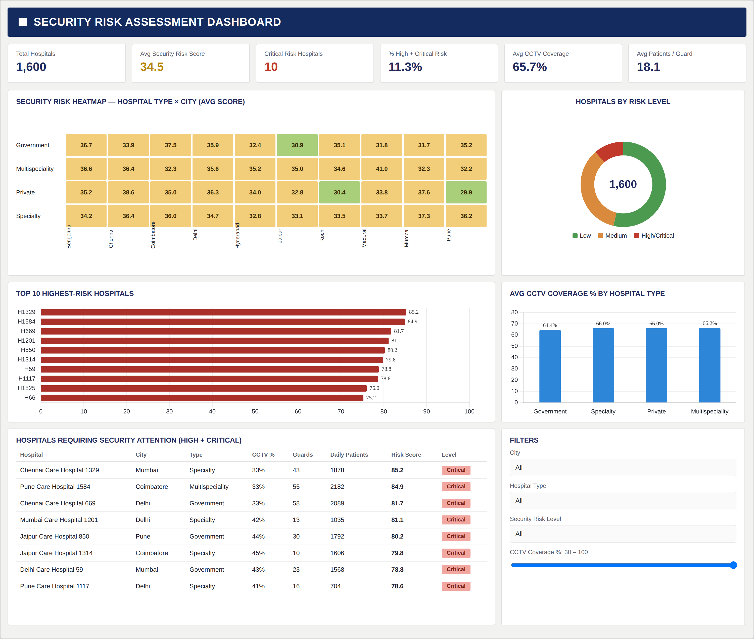
DASHBOARD 1 OF 5
Security Risk Assessment Dashboard
AT A GLANCE
TOTAL HOSPITALS
1,600
AVG SECURITY RISK SCORE
34.5
CRITICAL RISK HOSPITALS
10
% HIGH + CRITICAL RISK
11.3%
AVG CCTV COVERAGE
65.7%
AVG PATIENTS / GUARD
18.1
KEY OBSERVATIONS ► See next slide
Team 2 • Healthcare, Hospitality & Security Trends
4

Slide 5
DASHBOARD 1 OF 5 • KEY OBSERVATIONS
Security Risk Assessment — Insights
Risk Heatmap & Distribution
CCTV Coverage by Hospital Type
Interactive Filters
The Security Risk Heatmap reveals risk patterns across hospital types and cities. The distribution donut shows the majority are medium-to-low risk, with 10 hospitals flagged Critical.
Average CCTV coverage is similar across types: Government (64.4%), Specialty (66.0%), Private (66.0%), and Multispeciality (66.2%). No type significantly outperforms.
City, Hospital Type, Security Risk Level, and CCTV Coverage sliders enable dynamic filtering to drill into specific geographies or hospital segments.
Top High-Risk Hospitals
Security Attention Table
Summary
Hospital H1329 holds the highest risk score (85.2), followed by H1584 (84.9) and H669 (81.7). These have CCTV as low as 33% and serve up to 2,182 daily patients.
The "Hospitals Requiring Security Attention" table lists all High + Critical hospitals with city, type, CCTV %, guards, daily patients, and risk score for direct prioritisation.
This dashboard enables security teams to immediately identify which hospitals and locations require greater security attention based on quantitative risk scoring.
Team 2 • Healthcare, Hospitality & Security Trends
5

Slide 6
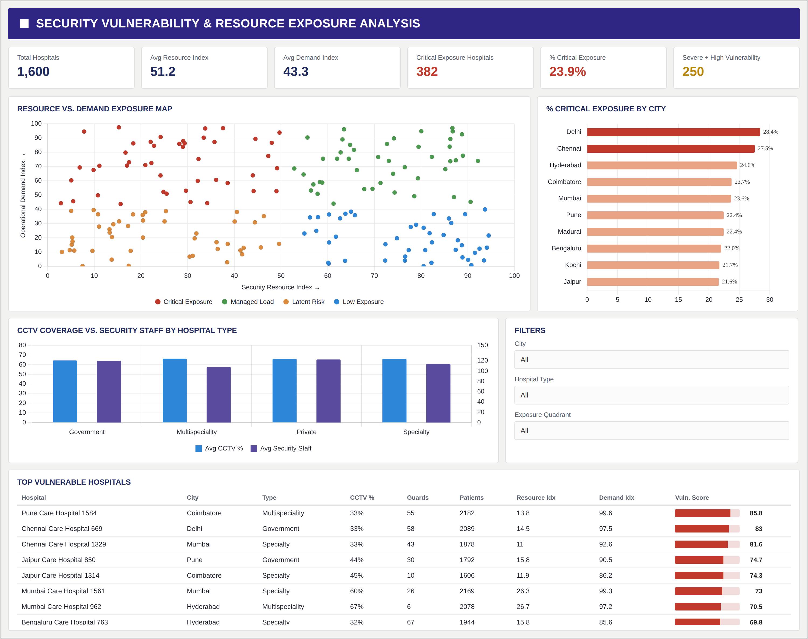
DASHBOARD 2 OF 5
Security Vulnerability & Resource Exposure Analysis
AT A GLANCE
TOTAL HOSPITALS
1,600
AVG RESOURCE INDEX
51.2
AVG DEMAND INDEX
43.3
CRITICAL EXPOSURE HOSPITALS
382
% CRITICAL EXPOSURE
23.9%
SEVERE + HIGH VULNERABILITY
250
KEY OBSERVATIONS ► See next slide
Team 2 • Healthcare, Hospitality & Security Trends
6

Slide 7
DASHBOARD 2 OF 5 • KEY OBSERVATIONS
Security Vulnerability & Resource Exposure — Insights
Resource vs. Demand Exposure Map
CCTV Coverage vs. Security Staff
Vulnerability Driver
The scatter plot maps Security Resource Index vs Operational Demand Index. Hospitals with high demand and low resources are Critical Exposure — 382 hospitals (23.9%).
Across all hospital types, avg CCTV (~60%) and security staff levels are consistent, yet exposure remains high — suggesting demand outpacing security capacity.
Security vulnerability increases when operational demand is high and security resources (CCTV, guards) are insufficient — making demand-adjusted resource planning essential.
Critical Exposure by City
Top Vulnerable Hospitals
Summary
Delhi (28.4%) and Chennai (27.5%) have the highest proportion of critically exposed hospitals, followed by Hyderabad (24.6%) and Coimbatore (23.7%).
Pune Care Hospital 1584 has the highest vulnerability score (85.8) with demand index 99.6 and only 33% CCTV. Chennai Care Hospital 669 follows at 83.
This dashboard exposes the gap between security resources available and operational demand, identifying hospitals most at risk from resource-demand mismatches.
Team 2 • Healthcare, Hospitality & Security Trends
7

Slide 8
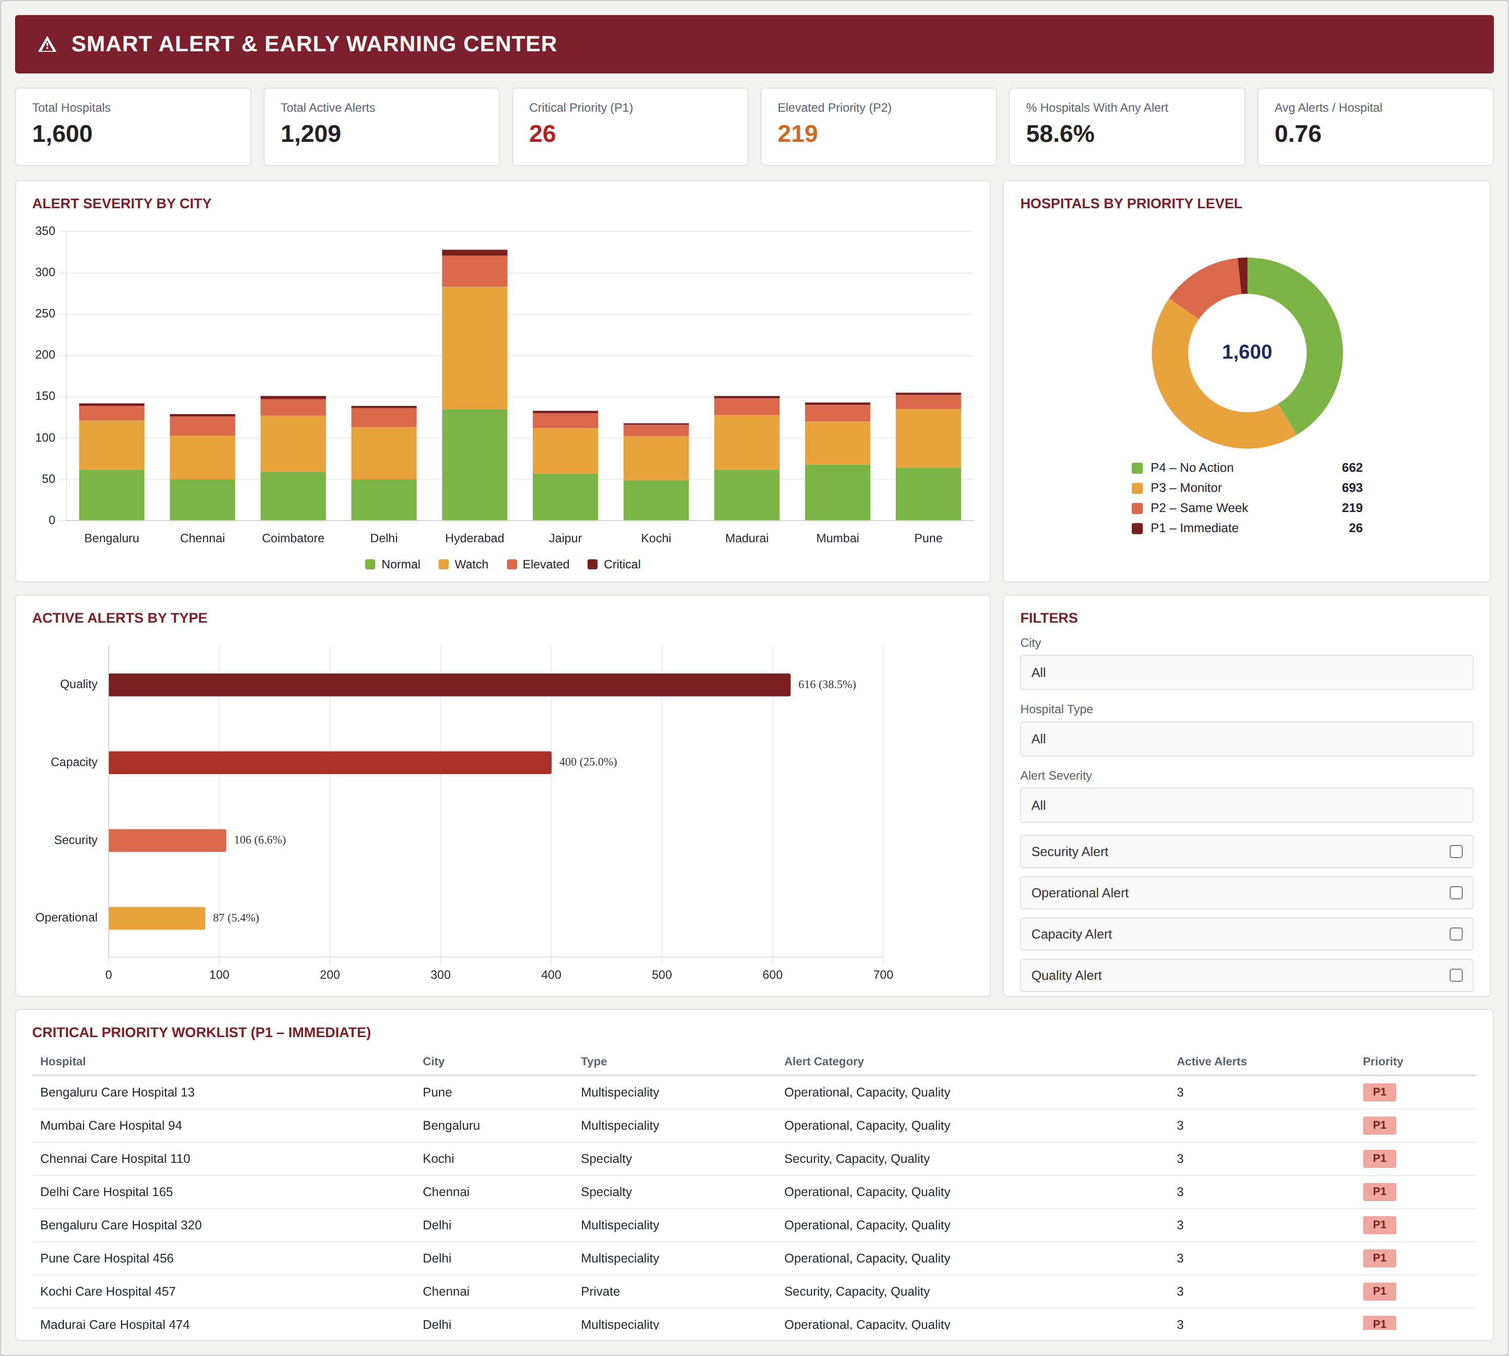
DASHBOARD 3 OF 5
Smart Alert & Early Warning Center
AT A GLANCE
TOTAL HOSPITALS
1,600
TOTAL ACTIVE ALERTS
1,209
CRITICAL PRIORITY (P1)
26
ELEVATED PRIORITY (P2)
219
% HOSPITALS WITH ALERTS
58.6%
AVG ALERTS / HOSPITAL
0.76
KEY OBSERVATIONS ► See next slide
Team 2 • Healthcare, Hospitality & Security Trends
8

Slide 9
DASHBOARD 3 OF 5 • KEY OBSERVATIONS
Smart Alert & Early Warning — Insights
Alert Severity by City
Active Alerts by Type
Early Warning Value
Hyderabad leads all cities with the highest total alert count (~325). Alert severity is stacked across Normal, Watch, Elevated, and Critical categories.
Quality alerts are the largest category (616, 38.5%), followed by Capacity (400, 25.0%), Security (106, 6.6%), and Operational (87, 5.4%).
The dashboard enables proactive management by surfacing hospitals before escalation — 693 P3 hospitals can be monitored before reaching Critical (P1) status.
Priority Level Distribution
Critical Priority Worklist
Summary
P4 No Action (662), P3 Monitor (693), P2 Same Week (219), P1 Immediate (26). The 26 P1 hospitals require immediate management response.
The P1 worklist identifies 26 hospitals requiring immediate action, showing city, type, alert categories (typically Operational, Capacity, Quality), and active alert count.
The Smart Alert Center supports early warning and prioritisation. Teams can use the worklist and filters to direct attention to hospitals requiring the most urgent intervention.
Team 2 • Healthcare, Hospitality & Security Trends
9

Slide 10
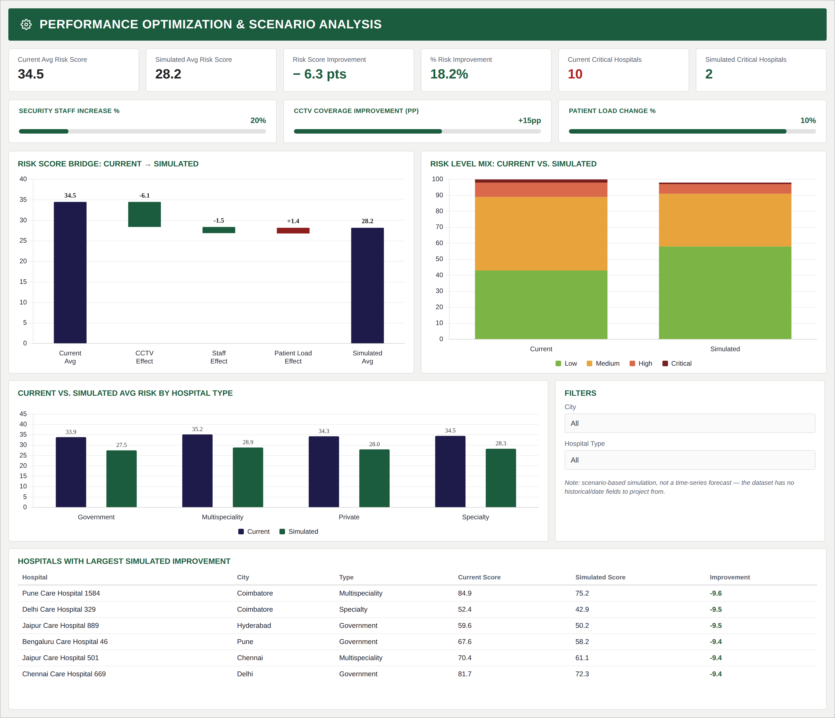
DASHBOARD 4 OF 5
Performance Optimisation & Scenario Analysis
AT A GLANCE
CURRENT AVG RISK SCORE
34.5
SIMULATED AVG RISK SCORE
28.2
RISK SCORE IMPROVEMENT
−6.3 pts
% RISK IMPROVEMENT
18.2%
CURRENT CRITICAL HOSPITALS
10
SIMULATED CRITICAL HOSPITALS
2
⚠ Scenario-based simulation — not a time-series forecast
Team 2 • Healthcare, Hospitality & Security Trends
10

Slide 11
DASHBOARD 4 OF 5 • KEY OBSERVATIONS
Performance Optimisation & Scenario Analysis — Insights
Scenario Parameters
Risk Level Mix Shift
Top Improvement Hospitals
Three adjustable factors: Security Staff Increase (+20%), CCTV Coverage Improvement (+15pp), and Patient Load Change (+10%). These can be tuned interactively via sliders.
Critical hospitals reduce from 10 to 2, and the Low risk share increases substantially in the simulated scenario vs. current state.
Pune Care Hospital 1584 shows the largest improvement (84.9→75.2, −9.6 pts), followed by Delhi Care Hospital 329 and Jaipur Care Hospital 889 (both −9.5 pts).
Risk Score Bridge
Risk by Hospital Type
⚠ Important Note
The waterfall chart shows: CCTV Effect (−6.1), Staff Effect (−1.5), Patient Load Effect (+1.4). Net result: average risk reduces from 34.5 → 28.2.
All four types show improvement: Government (33.9→27.5), Multispeciality (35.2→28.9), Private (34.3→28.0), Specialty (34.5→28.3) — broad-based potential.
This analysis is entirely scenario-based and represents simulated outcomes under defined parameter changes. It is NOT a time-series forecast. The dataset has no historical date fields.
Team 2 • Healthcare, Hospitality & Security Trends
11

Slide 12
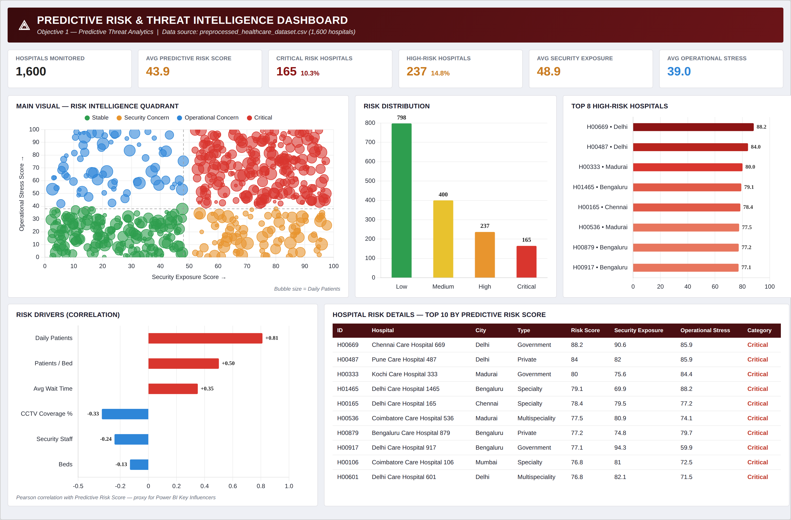
DASHBOARD 5 OF 5
Predictive Hospital Threat Analytics
AT A GLANCE
HOSPITALS MONITORED
1,600
AVG PREDICTIVE RISK SCORE
43.9
CRITICAL RISK HOSPITALS
165 (10.3%)
HIGH-RISK HOSPITALS
237 (14.8%)
AVG SECURITY EXPOSURE
48.9
AVG OPERATIONAL STRESS
39.0
KEY OBSERVATIONS ► See next slide
Team 2 • Healthcare, Hospitality & Security Trends
12

Slide 13
DASHBOARD 5 OF 5 • KEY OBSERVATIONS
Predictive Hospital Threat Analytics — Insights
Risk Intelligence Quadrant
Top High-Risk Hospitals
Hospital Risk Detail Table
The main scatter maps Security Exposure Score vs Operational Stress Score into four zones: Stable (green), Security Concern (orange), Operational Concern (blue), Critical (red). Bubble size = Daily Patients.
H00669 (Delhi, 88.2) leads, followed by H00487 (Delhi, 84.0) and H00333 (Madurai, 80.0). Delhi and Bengaluru account for the most high-risk hospitals.
A detailed table provides hospital ID, name, city, type, predictive risk score, security exposure, operational stress, and category for data-driven management prioritisation.
Risk Distribution
Risk Drivers (Correlation)
Summary
Low (798), Medium (400), High (237), Critical (165). Together, High + Critical account for 25.1% of the network — 402 hospitals requiring priority attention.
Daily Patients (+0.81) and Patients/Bed (+0.50) are the strongest positive risk drivers. CCTV Coverage (−0.33) and Security Staff (−0.24) negatively correlate — more resources reduce risk.
This dashboard analyses relationships between CCTV, security staffing, daily patient load, wait time, and operational stress to understand patterns associated with different threat levels.
Team 2 • Healthcare, Hospitality & Security Trends
13

Slide 14
CROSS-DASHBOARD INSIGHTS
Advanced Security Intelligence
01
Security Risk
02
Vulnerability & Exposure
03
Smart Alerts
High and critical risk hospitals are identified through security scores and risk-level analysis across all hospital types and cities.
Hospitals with high demand and limited resources may experience greater security exposure — resource-demand alignment is critical.
The early warning system helps prioritise alerts by type and severity, directing attention to the 26 P1-critical hospitals first.
04
Scenario Analysis
05
Predictive Threat Analysis
06
Decision Support
Simulated changes in security staff (+20%), CCTV (+15pp), and patient load (+10%) demonstrate an 18.2% potential risk reduction.
Operational and security factors — patient load, wait time, CCTV, staff — are analysed together to understand threat patterns.
The complete dashboard suite supports proactive, data-driven security decision-making across 1,600 hospitals in 10 cities.
Team 2 • Healthcare, Hospitality & Security Trends
14

Slide 15
PROGRESS & OUTCOME
What Milestone 4 Delivered
1,600
10
5
30+
Hospitals Analysed
Cities Covered
Dashboards Built
KPIs & Visuals
ADVANCED SECURITY ANALYSIS
SUMMARY
✓ Security Risk Assessment
Milestone 4 extends the existing dashboard development work into an advanced hospital security analytics and decision-support system.
The project now provides:
Risk Identification → Vulnerability Monitoring → Alert Prioritisation → Scenario Analysis → Predictive Insights
✓ Vulnerability & Resource Exposure
✓ Smart Alert System
✓ Early Warning Analysis
✓ Performance Optimisation
✓ Scenario Analysis
✓ Predictive Threat Analytics
Team 2 • Healthcare, Hospitality & Security Trends
15

Slide 16
CONCLUSION
Milestone 4 — Summary & Conclusion
Milestone 4 successfully extends the previous dashboard development work into a more advanced security intelligence and analytical framework.
THE PROJECT HAS EVOLVED THROUGH:
Data Preparation
►
Dashboard Development
►
Interactive Visualisation
►
Security Risk Analysis
►
Advanced Analytics
►
Predictive Threat Intelligence
THE DEVELOPED DASHBOARDS PROVIDE A UNIFIED VIEW OF:
Security Risks
Hospital Vulnerabilities
Resource Exposure
Critical Alerts
Improvement Scenarios
Threat Patterns
This demonstrates how the existing healthcare dataset can be transformed from simple visual reporting into a more advanced data-driven security decision-support system.
Thank You
TEAM 2
Kunal • Dinesh • Sarumathi
A live, interactive dashboard suite — from clean data to actionable security insight.
Team 2 • Healthcare, Hospitality & Security Trends
16

